Slide 1

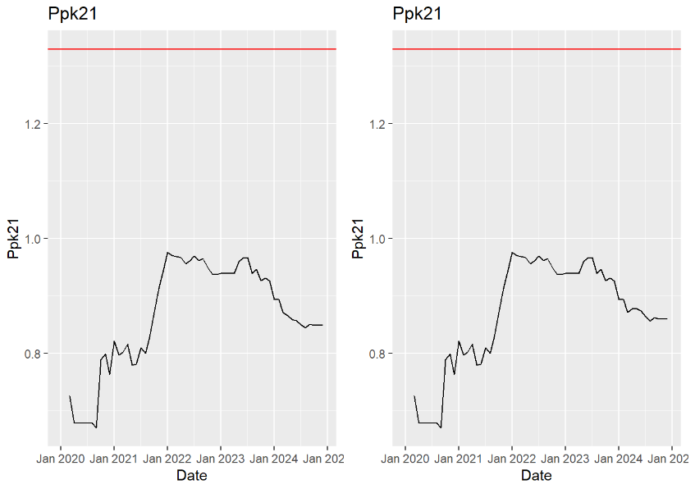
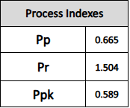
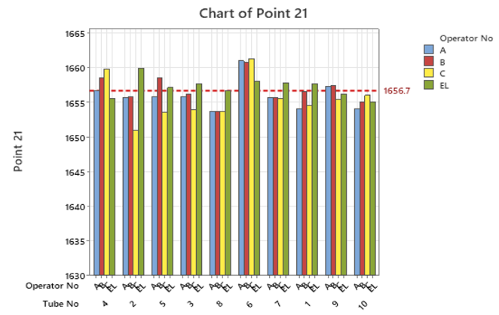
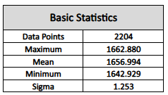
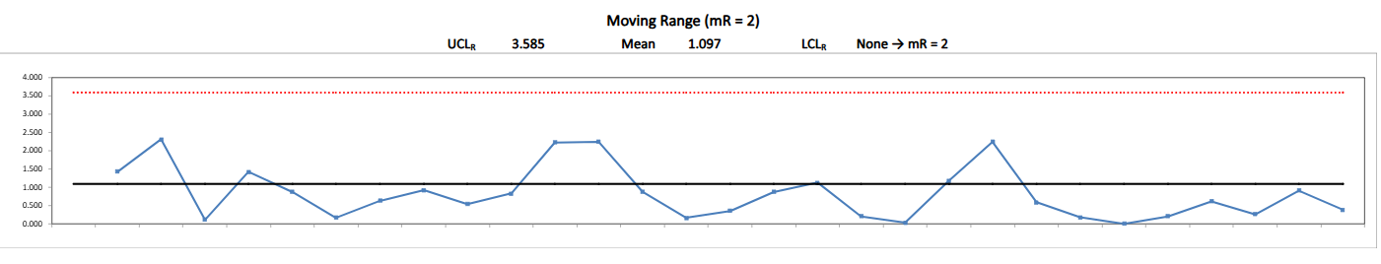
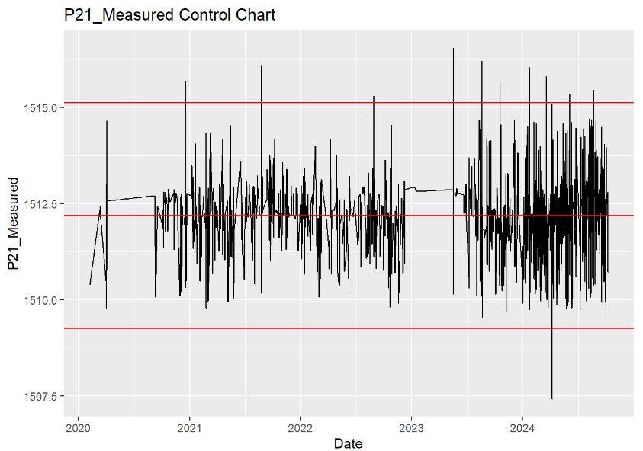
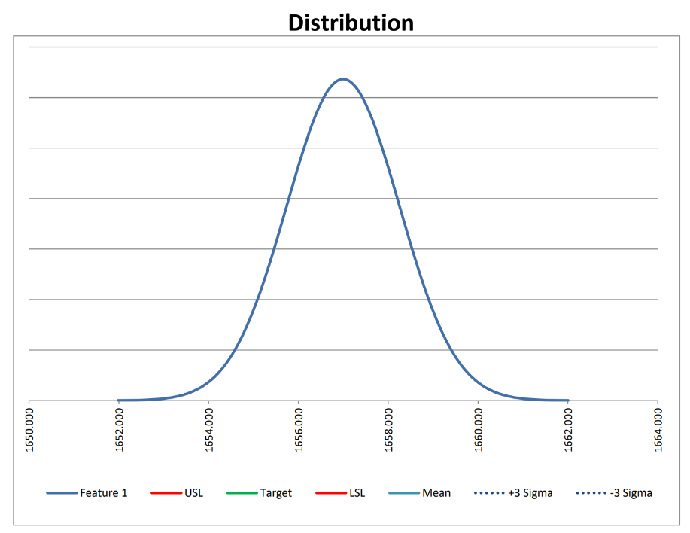
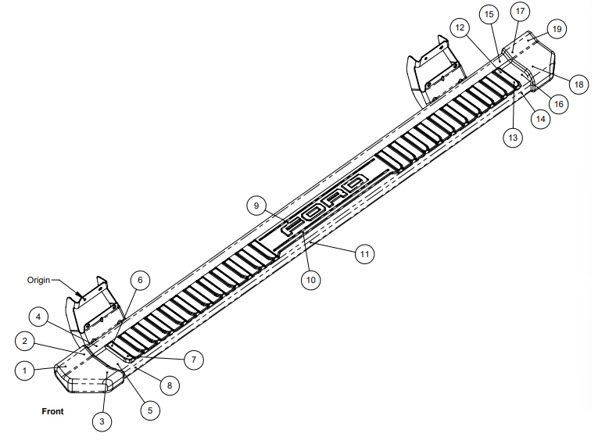
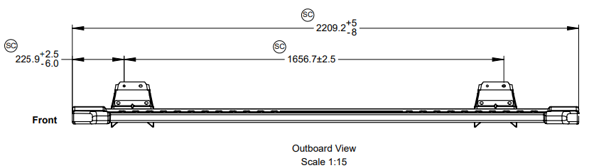
TEAM 8
IE 3610 Statistical Quality Assurance Semester Project
Braden Skaggs, Jacob Roberts, Ryan Nagao, Youngjae Cho
DeeZee & Ford Running Boards
Introduction
Analysis
Gauge R&R Results
DeeZee Inc. is one of the largest Original Equipment Manufacturers (OEM) in the automotive industry. In March 2025, Dee Zee will meet with their Ford Motor Company partners regarding the Ppk of various parts that the operators have measured throughout the past four years. Dee Zee is working on consolidating various histograms and charts to show an improvement in the quality of their parts and their conformance to the required tolerances and specifications set by Ford Motor Company as well as the process control variables required by Ford Motor Company, a Ppk value that is set at 1.33 by both Ford Motor Company and Dee Zee themselves. The goal of this project is to confirm that the data is following the expected Ppk value and find the cause for outliers within the data.
Point 21 Data Analysis
Other points showed comparable results to 21
Clear evidence of operator error within the measurement process
Further study found that repeated measurements by same operator had little variation
Repeatability more of an issue than reproducibility
Approach
Received 4 years of historical data from DeeZee on 2 parts measured from 22 different points
Used DeeZee's internal software to compile data
Utilized R-Studio to analyze trends within the data/create visuals
Find/assess validity of outliers
Control charts, Ppk spanning the four years
Helped perform a Gauge R&R Study to further analyze inconsistencies
Conclusions
Recalibrate measuring fixture to ensure accurate measurements
Familiarize employees with standardized loading and measuring procedures
Make the measuring platform more accessible for all employees
Create large Go/No-Go Gauge for hole width after laser operation
Gave DeeZee employees recommendations to analyze further historical data for other parts
Acknowledgements: Laurie Murphy, Nick Swift, Eric Jones, Ryan Peltier, Andrew Theobald, and The DeeZee Operations Team

Slide 2
TEAM XX
IE 3610 Statistical Quality Assurance Semester Project
Student Name(s)
Client Name
Poster Title
Text and headings should be no smaller than shown here! 48 pt for headings, 36 pt for text.
Elements that should not be changed
Do not alter the top (cardinal) header.
Insert student and client names on the gold header.
Replace the XX with your team number in the upper right corner
Edit the Poster Title but not the font or size.
Fill in the white space with your content. The templates in the next slides are suggestions! Feel free to modify how you lay out content.
Don’t forget the people that should be acknowledged in the footer (e.g. clients you worked with).
Acknowledgements

Slide 3
TEAM XX
IE 3610 Statistical Quality Assurance Semester Project
Student Name(s)
Client Name
Alternative Format 1 – 3 columns prevent the “tennis match” syndrome
Abstract, Problem Statement, Objectives
Methods/Materials/Data
Major Results and Conclusions
Words should mostly be in the form of bullets and phrases rather than complete sentences. You will be there to speak in sentences; your poster does not have to.
Distribute contents vertically within each column in whatever way makes sense
Emphasize graphics and tables rather than words. Borders are optional.
Acknowledgements

Slide 4

TEAM XX
IE 3610 Statistical Quality Assurance Semester Project
Student Name(s)
Client Name
Alternative Format 2 – some designers recommend 4 columns
RESEARCH BACKGROUND
RESEARCH APPROACH
RESULTS
LIMITATIONS AND FUTURE RESEARCH
Provide background for the research topic
Get the viewers interested
Place work in context
Insert photos, tables, charts in this area
Must be easily understood by educated person
Key equation(s) only with variable definitions
Leave spaces between columns, before subheads, figures, tables, etc.
Results/accomplishments to date
Questions remaining unanswered, or generated by what you learned
Ongoing research in your mentor’s group that might address them
RESEARCH OBJECTIVES
BENEFITS AND POTENTIAL USES
Goals of this particular research project
Place work in context
Outline potential benefits of this research
Outline potential uses of this research
RESEARCH DELIVERABLES
Text and bullets.
Text and headings should be no smaller than shown here! 48 pt for headings, 36 pt for text.
Consider adding a QR code that links to a relevant website: this one is imse.iastate.edu
Acknowledgements

Slide 5
